Slide 1
Installing Pyspark
This presentation will explain how to install PySpark on MacOS and automatically connect it to Jupyter Notebooks
Created by Dominique Paul for Prof. Johannes Binswanger (SIAW – University of St. Gallen)

Slide 2

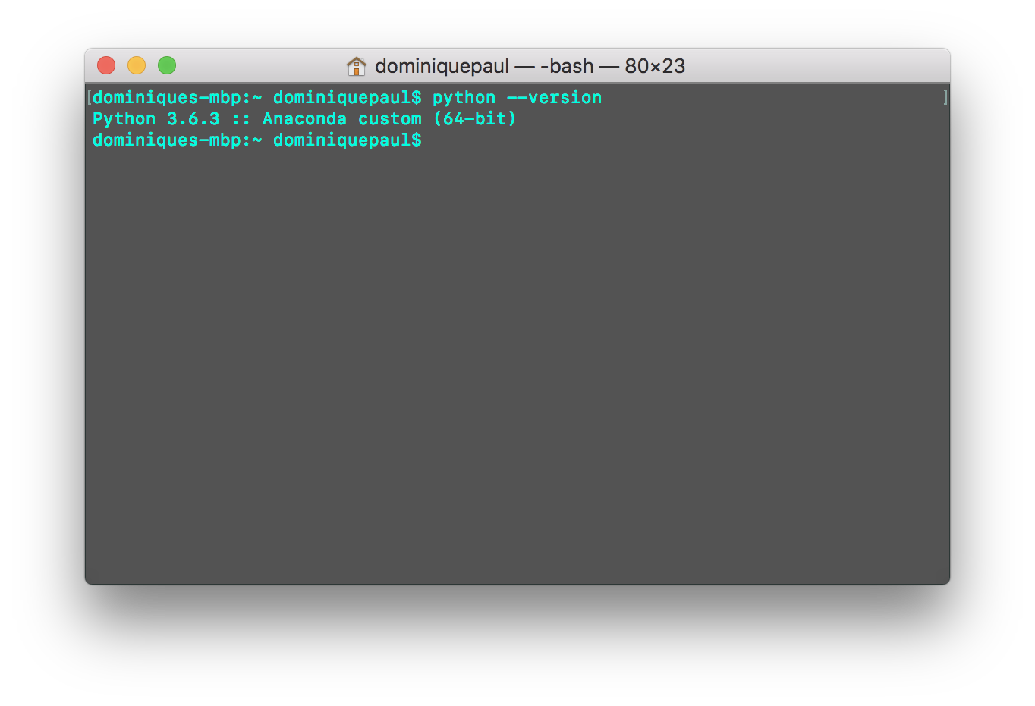
1. Python
We assume that you have python installed
If you are not sure, open Terminal and enter: python –version
If nothing shows up, install python from here: https://www.python.org/downloads/

Slide 3

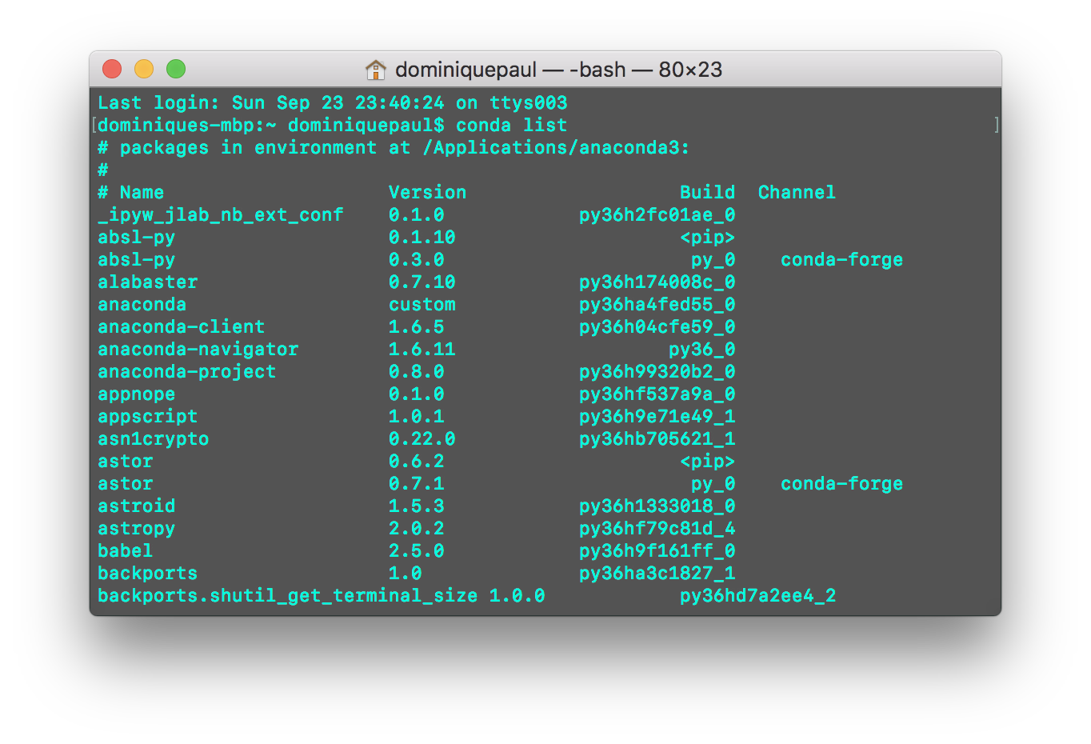
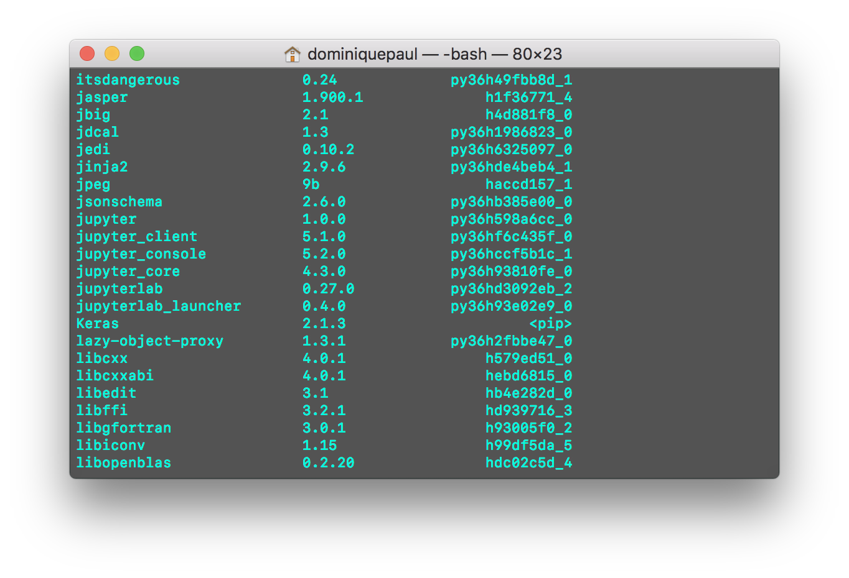
2. Jupyter
We also assume that you have Jupyter Notebooks installed
If you are not sure, open Terminal and enter one of the following: conda list pip list
Jupyter should be one of the packages listed
Anaconda comes with Jupyter Notebooks pre-installed
If you are working with pip, you can install Jupyter Notebooks with pip install jupyter

Slide 4
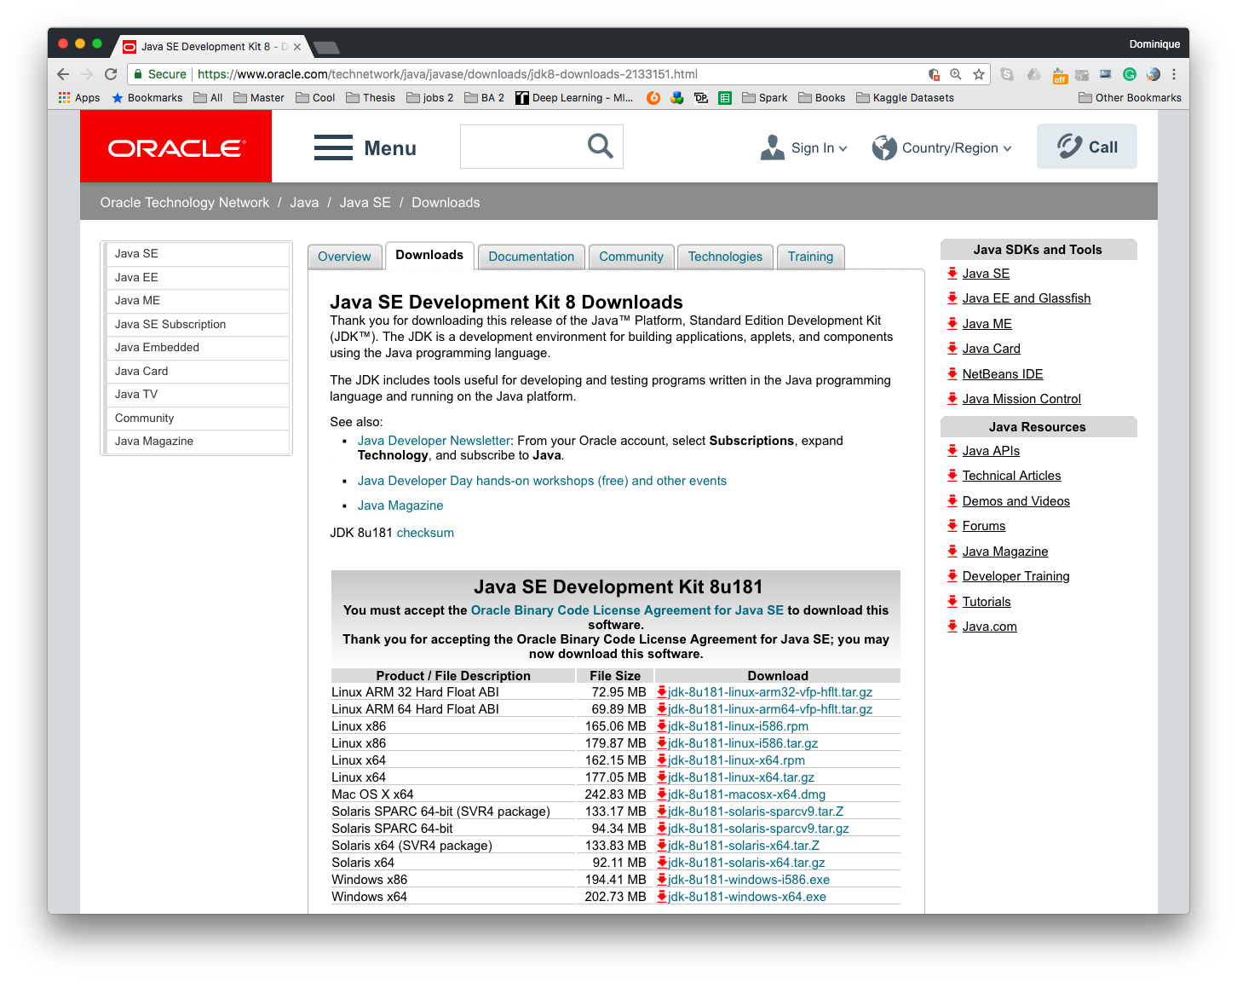
3. Java installation
To use PySpark, we will need the Java Developer Kit
Make sure that you are using version 8. PySpark may not work with other versions such as 10.0
Go to https://www.oracle.com/technetwork/java/javase/downloads/jdk8-downloads-2133151.html and download the version for your system
Once the download has completed, open the installer and follow the instructions

Slide 5
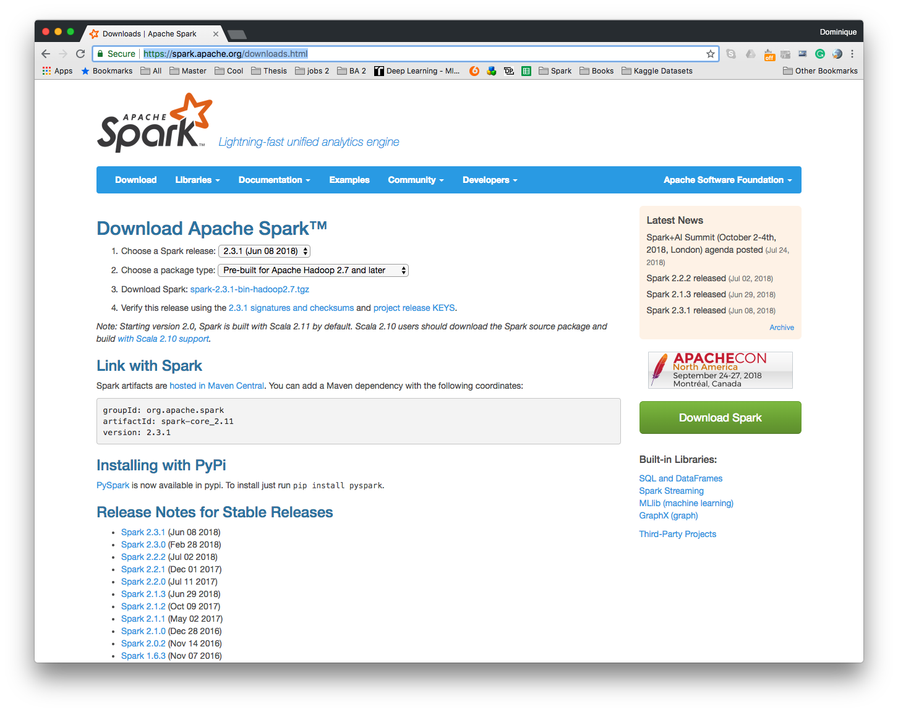
4. Download Spark
Go to https://spark.apache.org/downloads.html
Download the latest stable version of Spark based on a pre-built version for Apache Hadoop

Slide 6
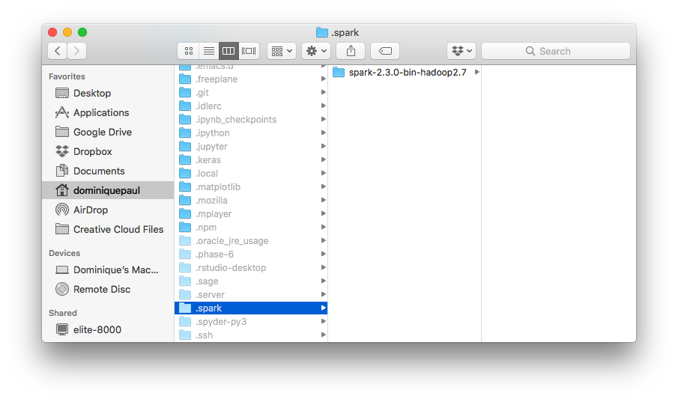
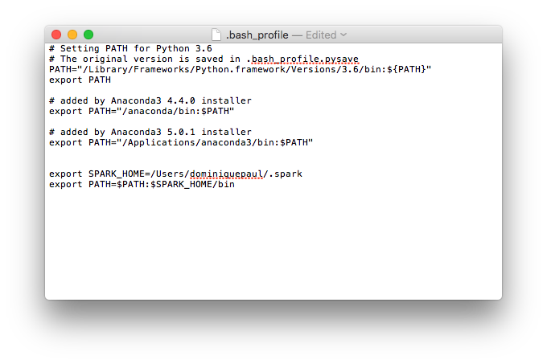
4. Installing Spark
In your finder home directory, press (command + shift + .) This will reveal all hidden folders and files. You can reverse this by using the same keyboard shortcut again.
create a folder called “.spark” and move the unzipped Spark folder into it.
Right click (ctrl + click) onto the spark folder and click on “copy spark as pathname)
Go back to your homedirectory and open the file called “.bash_profile”. This will open the file in textedit.
In the file, add the following lines, thereby replacing “YOUR_FILEPATH” with the filepath of the spark folder you just copied: export SPARK_HOME=YOUR_FILEPATH export PATH=$PATH:$SPARK_HOME/bin

Slide 7
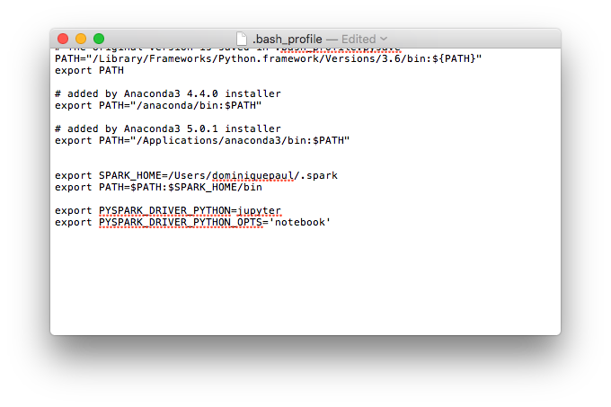
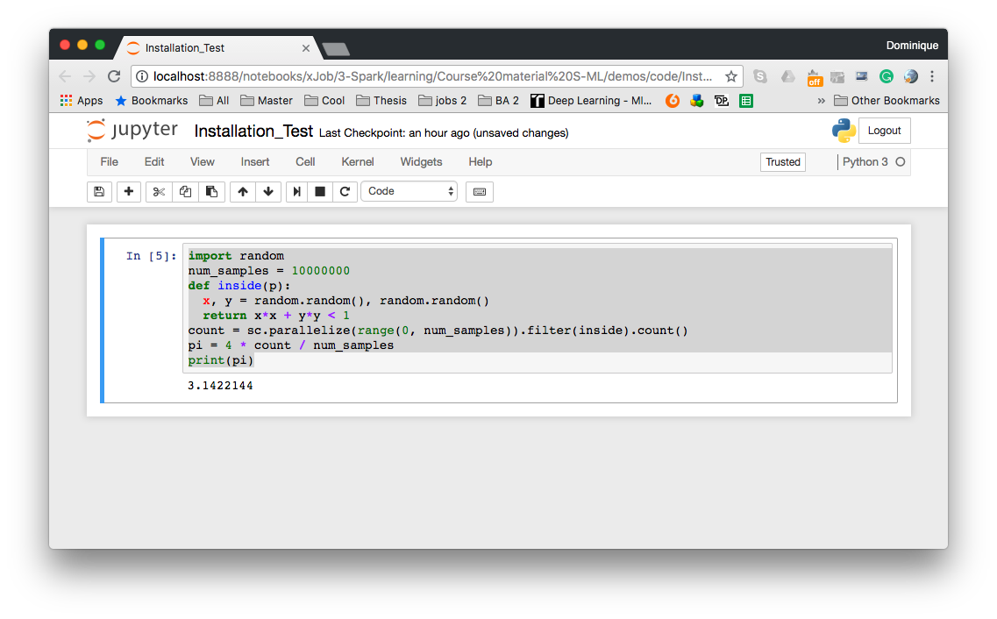
4. Making the Jupyter connection
In the same .bash_profile file, add the following two lines: export PYSPARK_DRIVER_PYTHON=jupyter export PYSPARK_DRIVER_PYTHON_OPTS='notebook’
Save the .bash_profile file and open terminal. If you had it open already, quit it (command + Q) and re-open it so it can re-load the .bash_profile file
Enter pyspark in the terminal, this opens a new Jupyter Notebook with a spark connection.
Test whether the installation is successful by running the code on the next slide

Slide 8
Code snippet
import random
num_samples = 10000000
def inside(p):
x, y = random.random(), random.random()
return x*x + y*y < 1
count = sc.parallelize(range(0, num_samples)).filter(inside).count()
pi = 4 * count / num_samples
print(pi)

